Slide 1
SOP4chem – simplex optimization procedure for chemistry
Matthew.Lewis@gmail.com

Slide 2
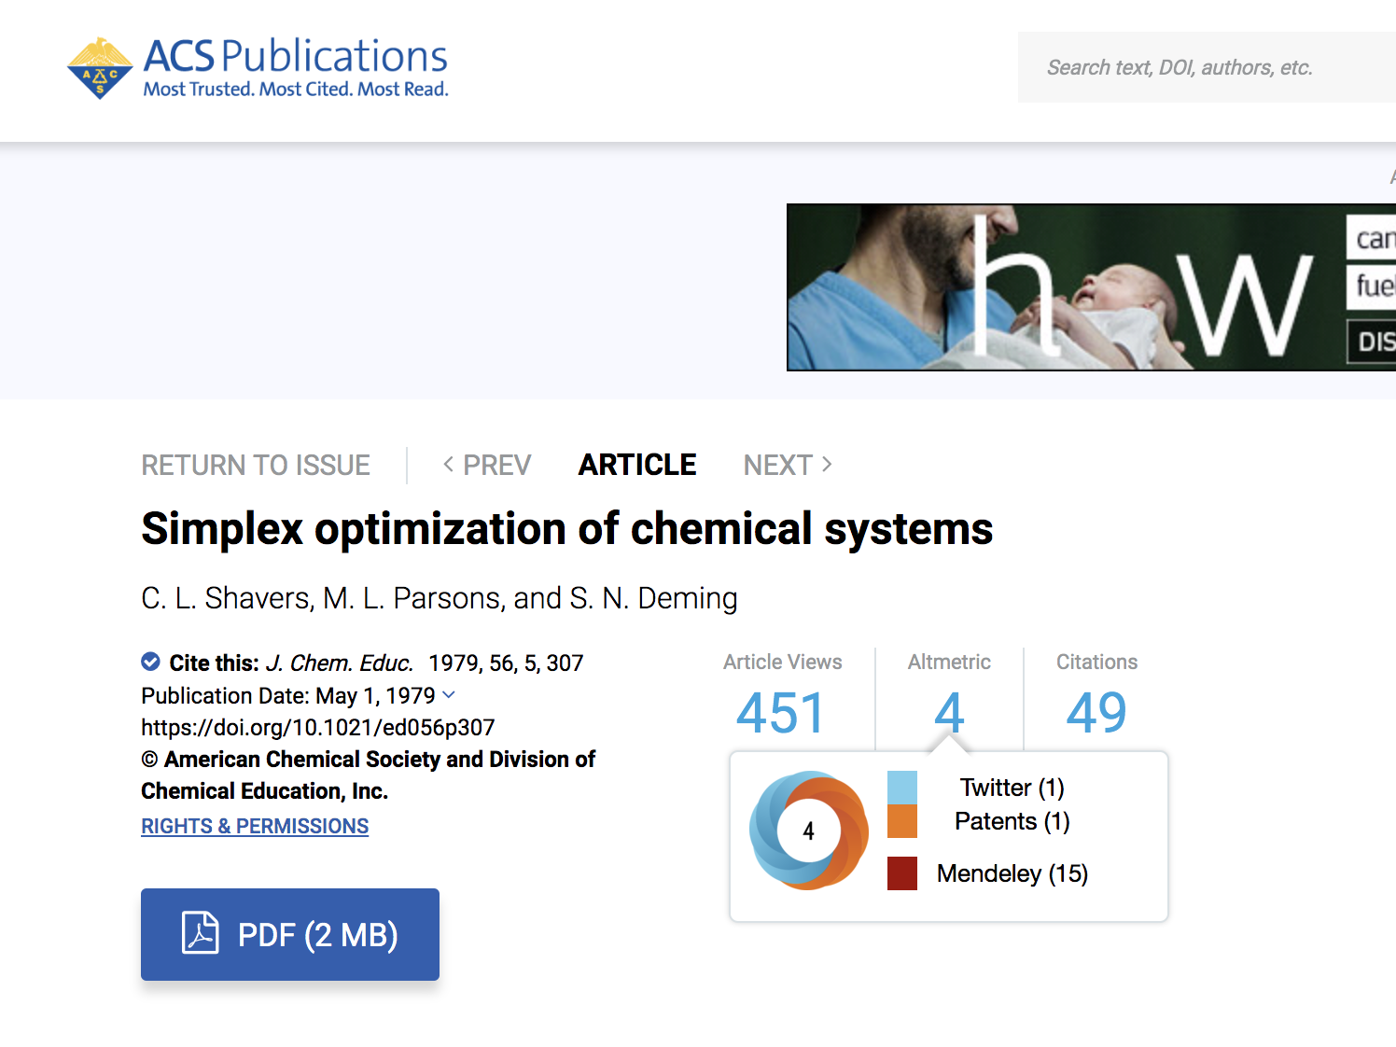

Slide 3
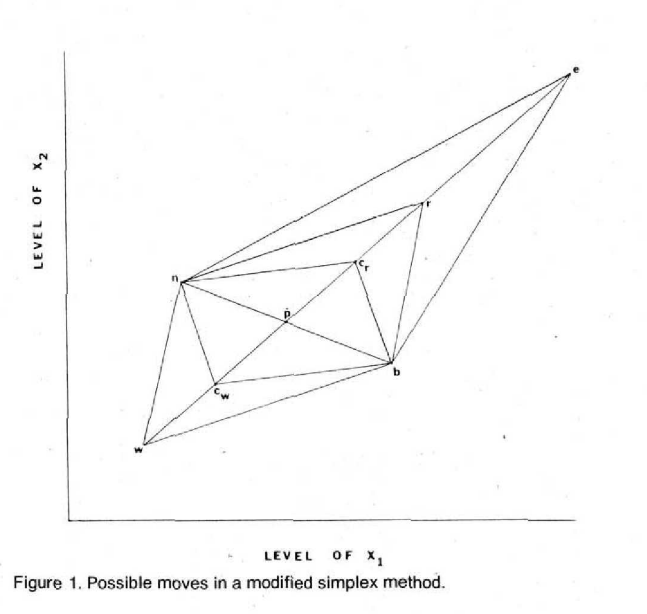
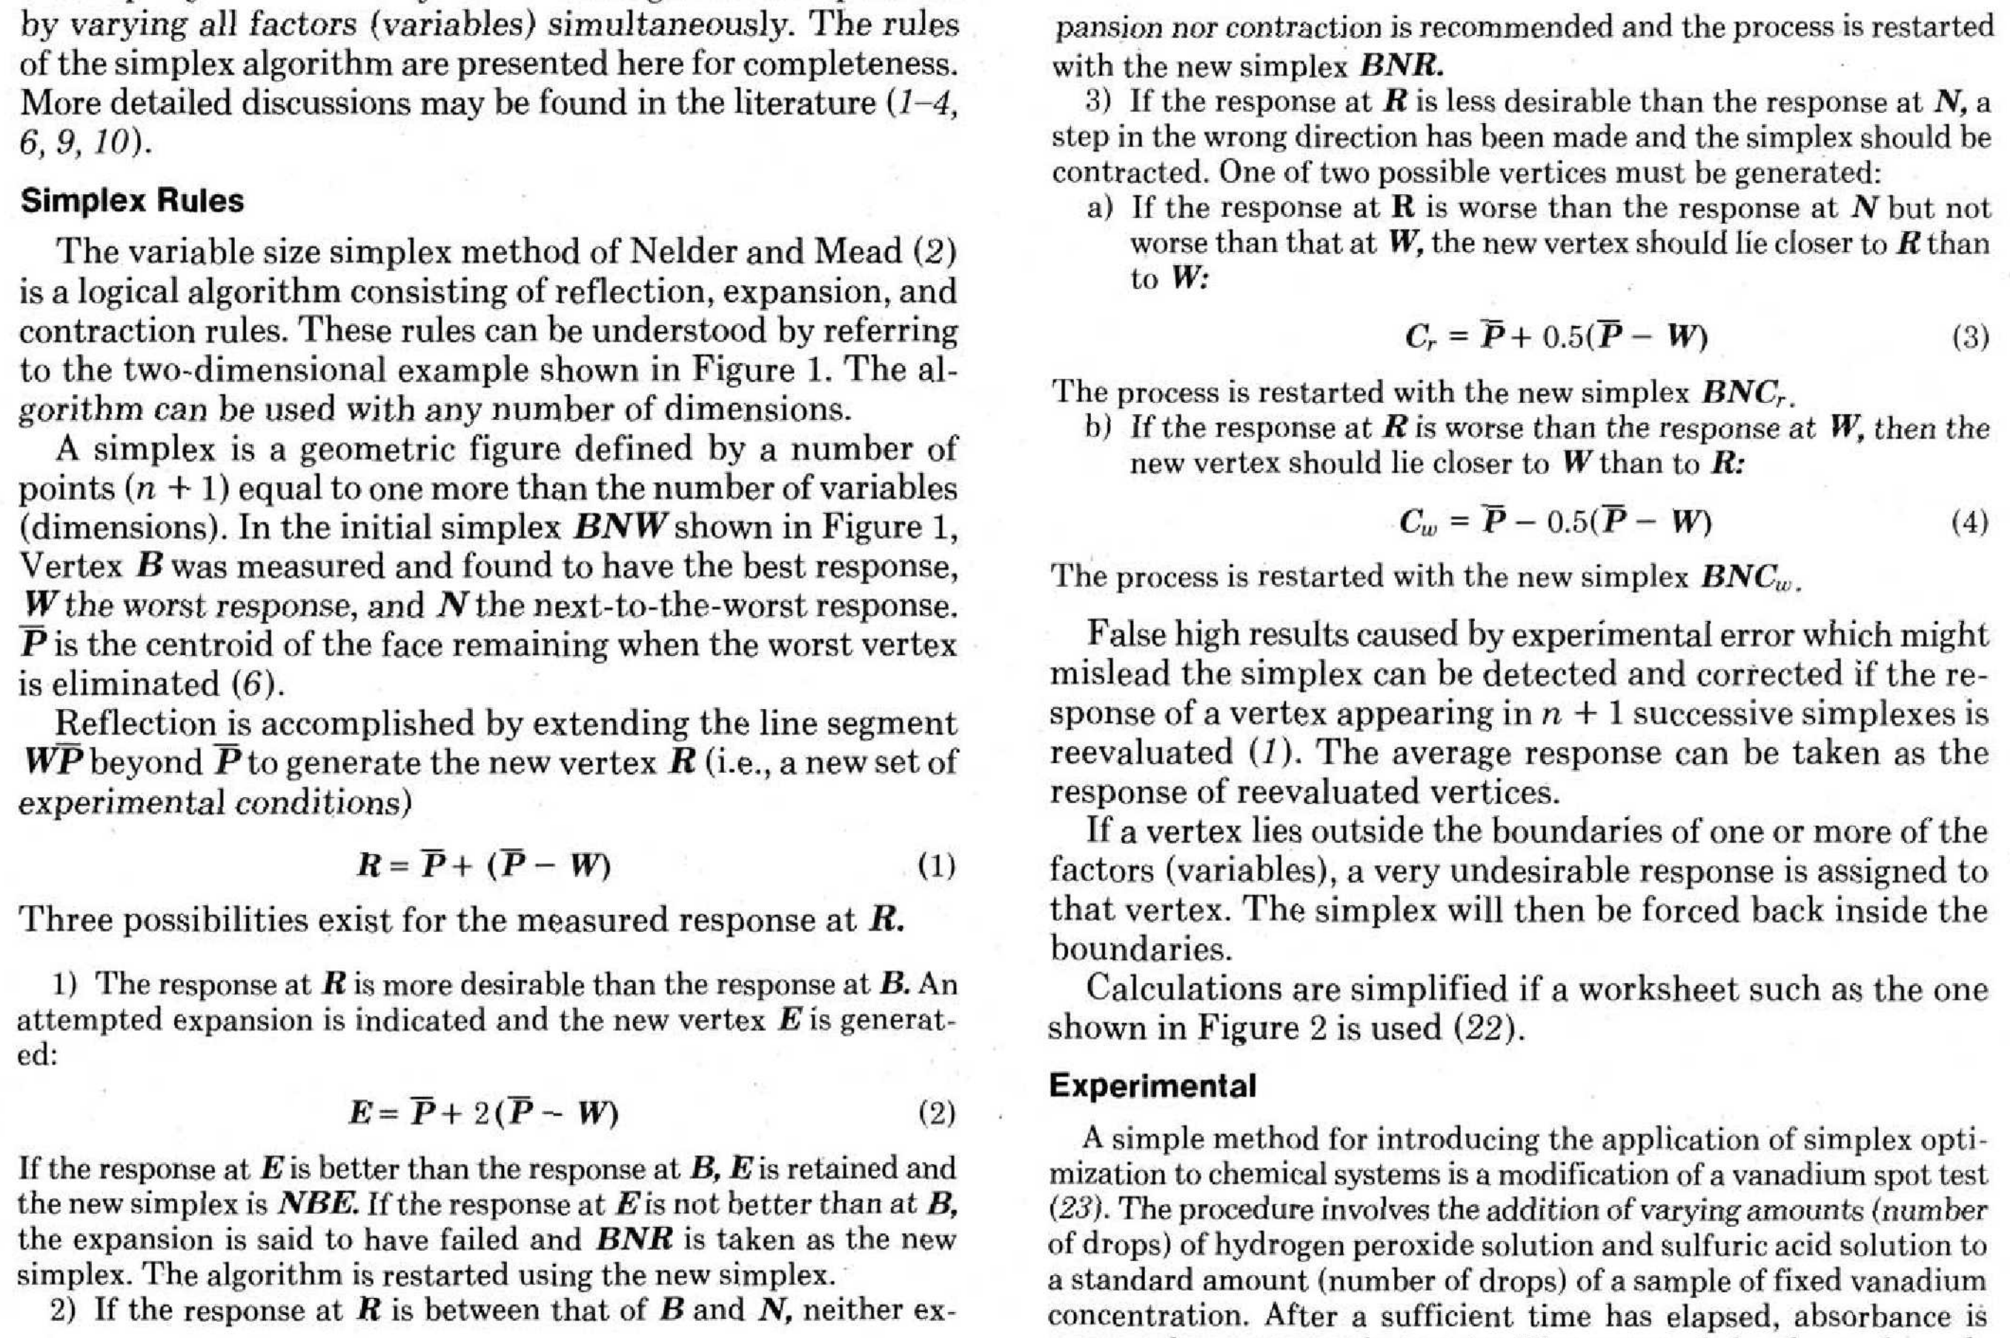
These rules are implemented. Additionally, if boundary constraints are employed and a pivot vertex is outside the allowable range, rule 3a is applied repeatedly until pivot vertex is valid.

Slide 4
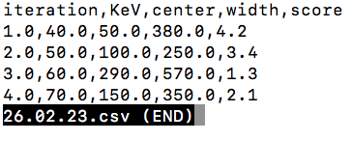
Input files
CSV file with initial experiments and ‘scores’/utility values
First column must be labeled ‘iteration’
Followed by 2 or more columns with experimental parameters and arbitrary labels
Last column must be labeled ‘score’
Additional number of rows should be one greater than number of experimental variables to properly define simplex. If there are additional rows, extra rows at the top will be ignored.

Slide 5
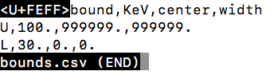
Input files
All experimental parameters can be optionally constrained using a second CSV file
First column must be labeled ‘bound’ and rows must be labeled ‘U’ and ‘L’ for upper and lower bounds.
Experimental parameters must be in same order as data input CSV.
Unicode encoding character at start of file can be safely ignored. Partial constraints are not supported. Use large magnitude numbers to simulate one-sided bounds.

Slide 6
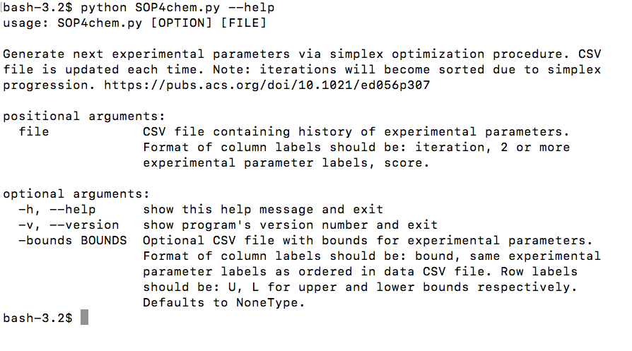
Python3 only

Slide 7
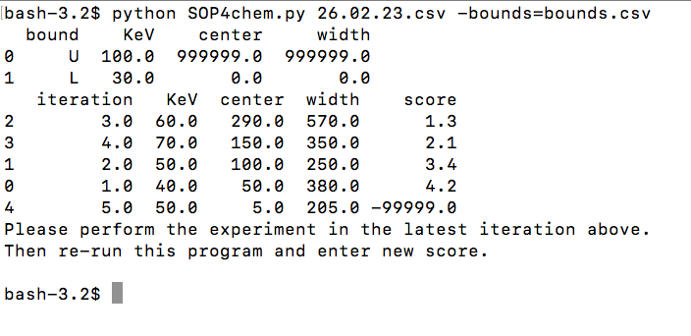

Slide 8
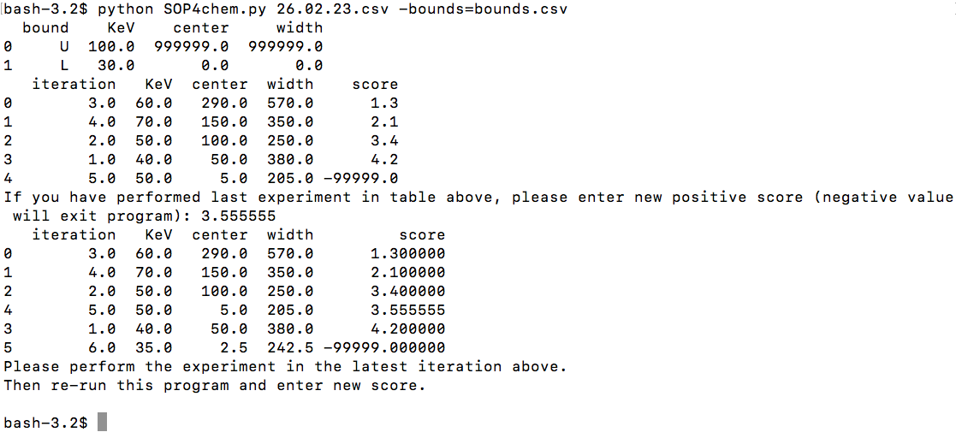

Slide 9
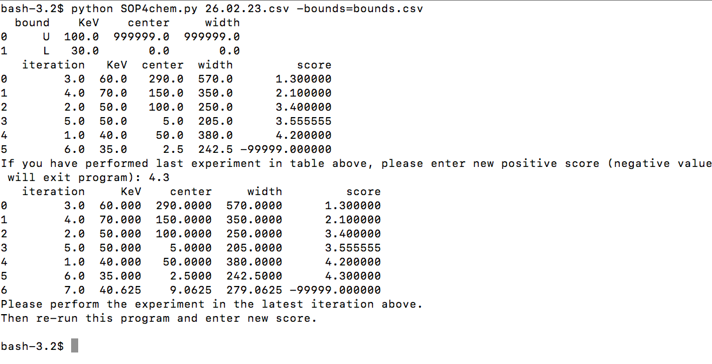

Slide 10
Notes
The iteration dataframe table stores the simplex values that were used in calculations.
In some cases, the experimental parameters that you used in additional experiments will be changed in the CSV file according to the simplex rules.
It should be easy to a create separate log file that records all experimental results if truly needed. Contact the author.

